Slide 1
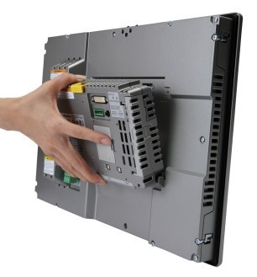
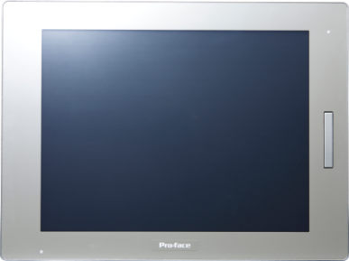
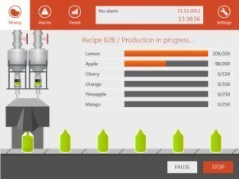
SP5000 series
New Value for your machines
Digital Electronics Corporation

Slide 2
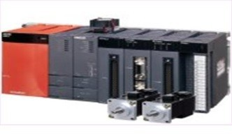
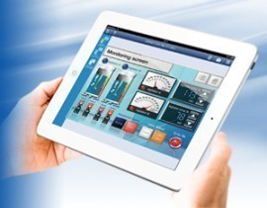
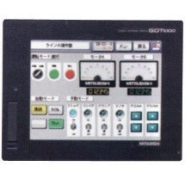
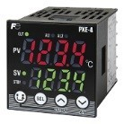
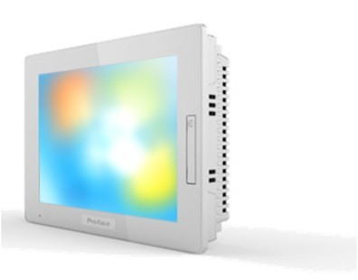
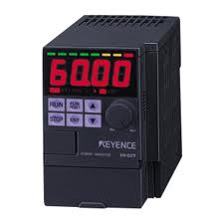
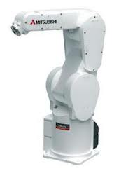



Vision of Pro-face
Close | Open
Competitors
Communicate through PLC
Pro-face
Direct communication with many controllers
Need I/F card and Logic program on PLC
Simple, Compact & More Info.
Need drawing one by one
Show info that each devices have
Info on PLC only
#1 no. of drivers.
Communicate many devices
１1
０１
Closed network
0０
１０
0０
１０
Maintain variety of controllers by HMI (Pre-set screen)
Require each tools to maintain each devices
Connectivity

Slide 3

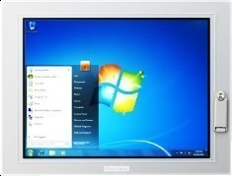




SP5000 Series Product Positioning
Offer New Interface terminal to create new category
* SP5000 is NOT successor of GP4000
Information
Industrial
Panel Computer
PS4000
SP5000
New Market
GP4000T
High-End
HMI
GP4000W/M
Standard
HMI
GP4100
Small
HMI
Performance

Slide 4
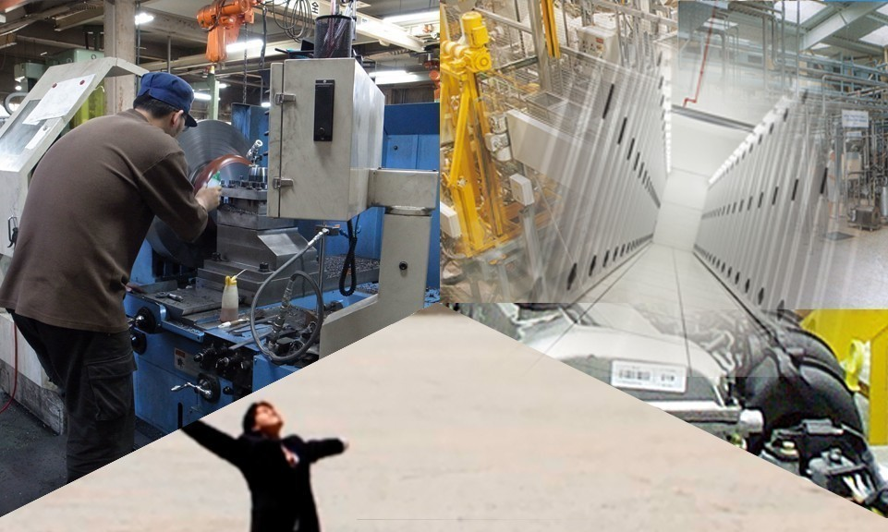

Concept
Valuable information
Secure data handling
Smart Portal
Optimized information
Simple to use
Notes:
SP = Smart Portal → It will be window for Machines (Facility) . It means that if there is a SP5000 Series on machines, people know status of the machines and connect machines to enterprise network system
SP5000 Series offer following three elements
1. Provide more valuable information for operators and maintenance people for more effective operations, sooner actions, and reduce cost
2. Connect controllers info to enterprise network safe and stable. → we could not image to use tablet at factory three years ago, but now we see some customers start using it. We think in near future, cloud service or Big data management will be key for manufacturing. Then SP5000 Series will be key devices to achieve the system.
3. And SP5000 Series is easier mounting and easier maintenance. So customers can easily put the such intelligent devices to their machines.

Slide 5


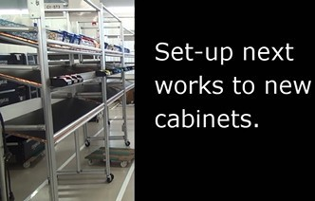






Utilize best suitable applications
Valuable information
Function
Trouble shooting
Show Instruction to support operators
Utilize existing manual
or trouble shooting guide
Easily update manual etc.
(USB, Network PC)
Inspection file
Browser display
Operating instructions
As subpanel (instructions)

Slide 6




HMI + customer’s own applications
Valuable information
Function
Controller setting tools
and/or
Own windows application
Windows application can be used
without any processing
Communicate HMI with customer's own
applications via API
5GB free space available
2nd CFast / SD card storage
Robot Config Tool
Conveyer tool
Detection algorism
Calculation program

Slide 7
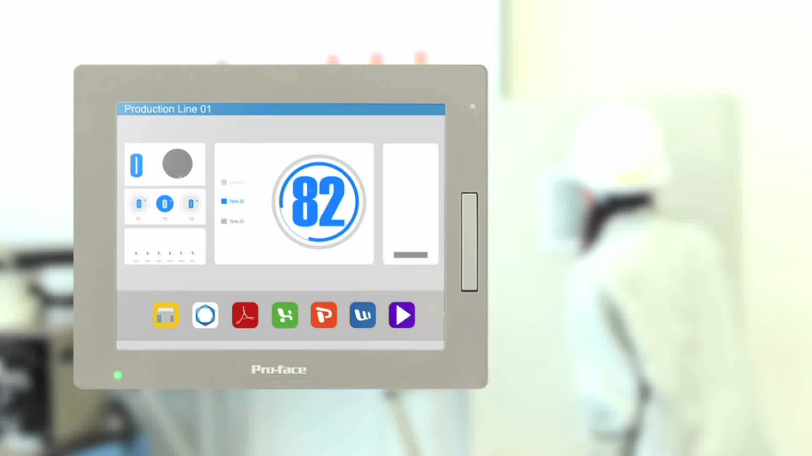

Slide 8
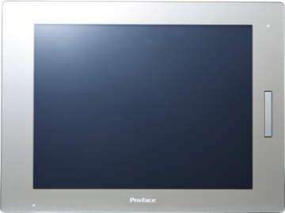



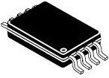
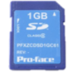
Increase its reliability
Secure data handling
Function
Protected
Even sudden power failure, OS not crush
Not lose historical data (NVRAM in)
Reliable with Spindle-less disk
Launcher tool
helps you for maintenance / set-up
NVRAM

Slide 9
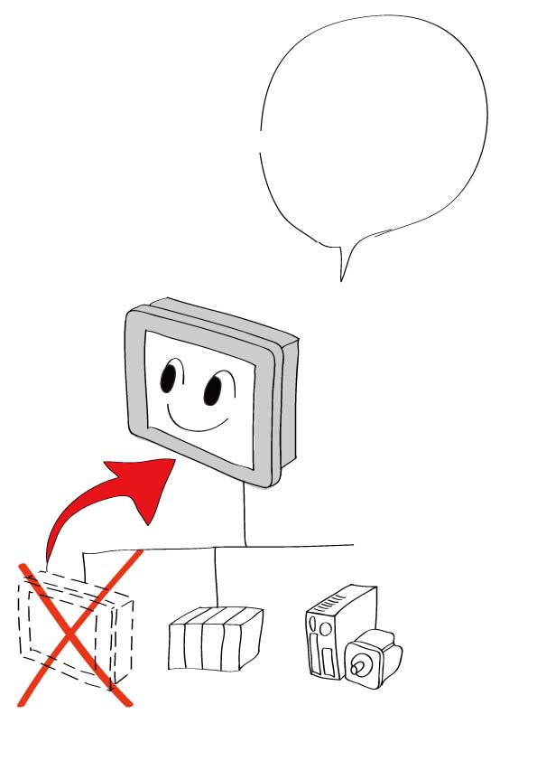
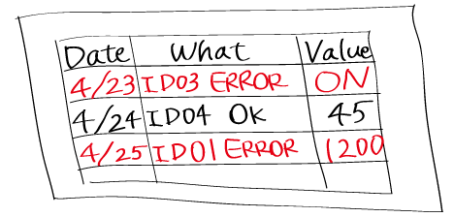
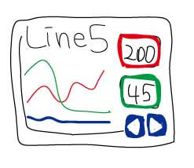
Compact, but high secure system!
Secure data handling
Your value
Improve reliability
by NVRAM & Spindle-less system
Protect OS and logging data
even unexpected power failure.
Reliable and no extra cost
for battery or maintenance
Use Flash media with high reliability
Improve production ratio
thanks to low failure rate
Effective product life cycle
thanks to longer product availability
Create reliable system easily thanks to
System set-up tool pre-installed

Slide 10
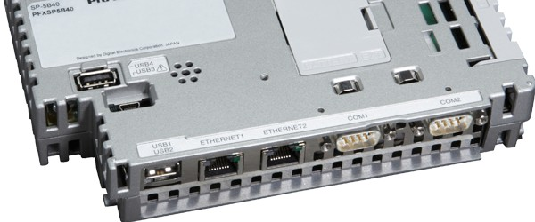
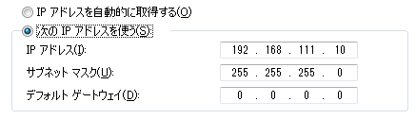
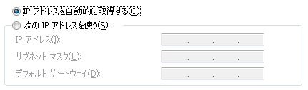
Dual-IP for enhance networking
Secure data handling
Function
Easy Network segmentation for Safety
Space saving by integrated Gateway
Simple collaboration with IT dept.
No need reconfiguring the IP address
Dual Ethernet/IPs

Slide 11
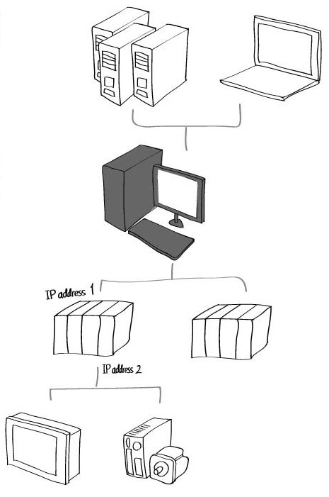


Many additional devices, Communication with other Dept. for networking?
Secure data handling
Current issue
Install PC or Router
To use 2 different IPs,
Need to add Ethernet Card to PLC.
Install Router
for routing 1 IP to devices at the field.
Needs extra space and Costs
for PC/Router
Takes time & effort to buy PC
because IT dept. manage it.
No PC or Router now
Increase IPs to add local IP devices to
office network and Costs to manage
Need resetting IPs at the field
after check which IP End-User use.

Slide 12
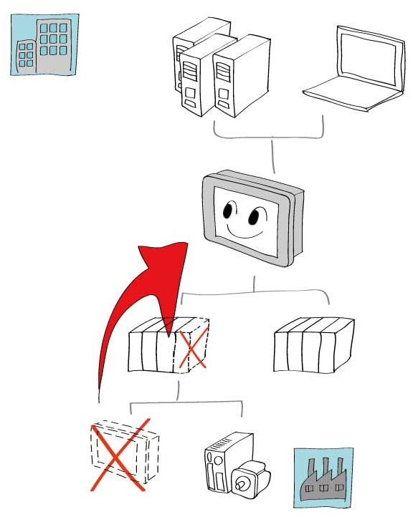
Safety Network even Simple system structure
Secure data handling
Your value
Gateway for Manufacturing floor
& Office Network
Easily connect to controller and
office network without no
additional Ethernet card or Router.
Reduce cost.
Interface terminal, not PC.
No need to apply to IT dept. to use.
Reduce devices communicate
with Office network.
No need to change local IP address.

Slide 13
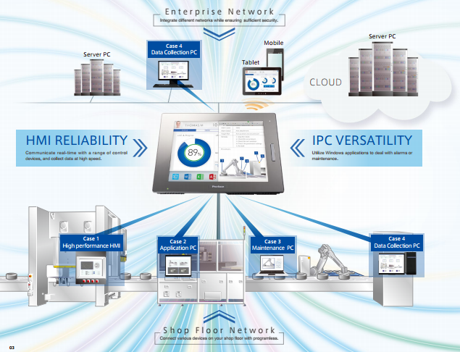
links 2 separate worlds

Slide 14

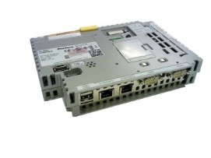
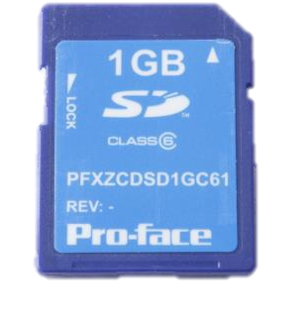
Easy replacement by modular design
Simple to use
Function
Leave display on cabinet
Thanks to Modular design
Easy replacement without PC
Memory card secured by Password
Easy & Simple mounting process
Remove
↓
Insert

Slide 15
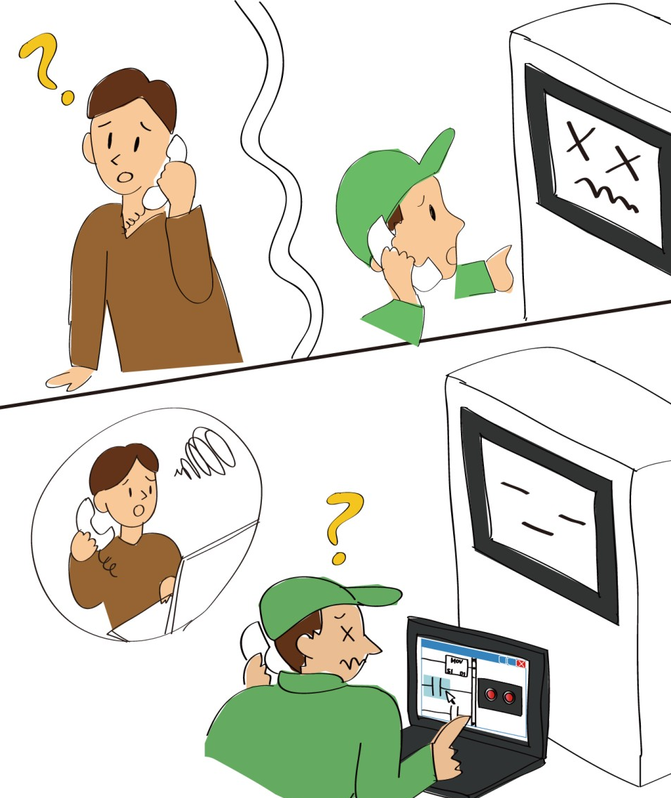
Take time & effort to replace or update by End-User?
Simple to use
Current issue
Takes time & effort to teach
how to transfer screen data
to End-User.
Need to go to field
just for screen transfer.
No tools to transfer screen data
- No Software
- Different version of Software
- No transfer cable
Need bug fix or update after delivery.
Takes time & effort to
update screen data.
Need to replace HMI & transfer screen,
even just display got old/broken

Slide 16
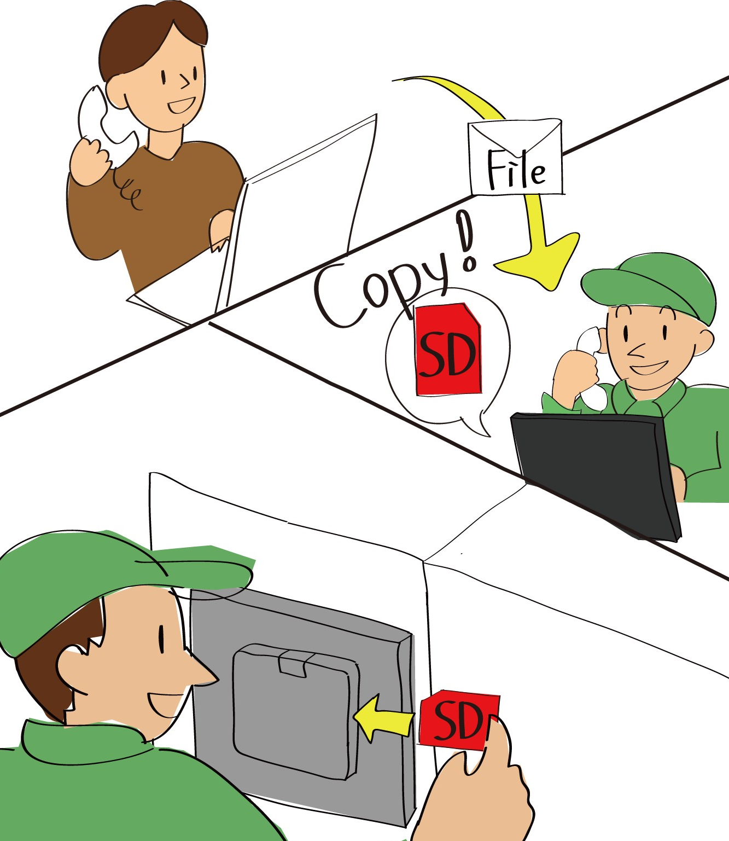
Easy & Simple: everyone can make it
Simple to use
Your value
Just insert CFast/SD card
for system replace
Everyone can update/recover easily
without visiting or explanation
by phone.
No need to train
End-User/Maintenance people
Just send new data by E-mail
for update
When Display broken,
Just replace Display and Keep using
BOX (with screen data)

Slide 17

Flexible Display size changes
Simple to use
Function
Auto-scaling features
No change the project file for each size
 |  | Display module
 |  | SP5500TPD (SVGA) | SP5600TPD (XGA) | SP5700TPD (XGA)
Screen Data | SP5500TPD (SVGA) | SVGA | XGA | XGA
 | SP5600TPD (XGA) | SVGA | XGA | XGA
 | SP5700TPD (XGA) | SVGA | XGA | XGA

Slide 18

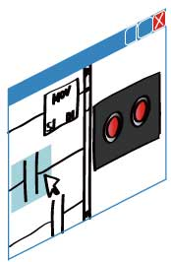




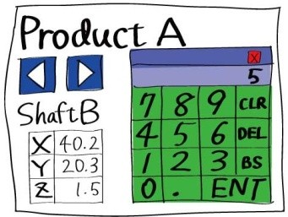
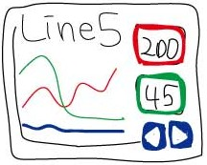

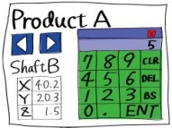
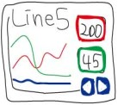
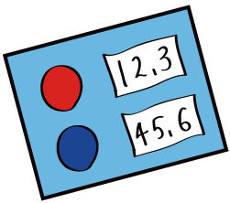

Take huge time to update screen data file, when use multiple display size?
Simple to use
Current issue
When update one file,
Need to update all files
for each display size too.
(Need running cost)
Even utilize screen data for other size,
takes time for small adjustment.
To reduce screen creating time
(standardization), Come with over
performance for low-end machines
Sometimes customer request
other display sizes than standard one
and Need to create new screen data.

Slide 19
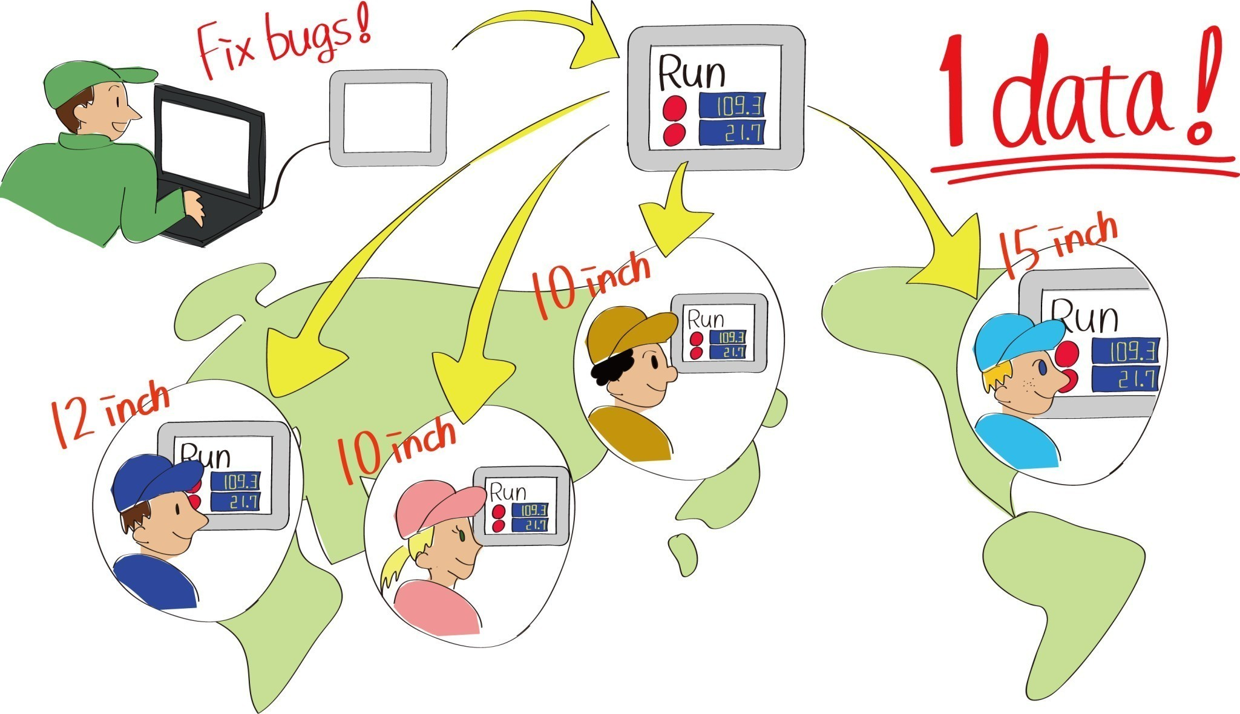
One changes for all seizes of screen
Simple to use
Your value
One master data can be used
for 10” – 15” display!
One master data for various needs.
Reduce developing time
and Quick start-up!
Manage just one master data.
Reduce screen creating
and management time!

Slide 20
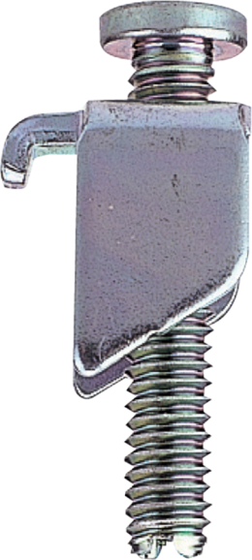
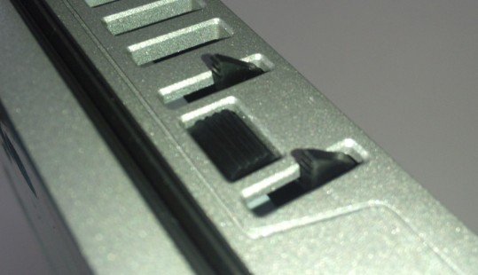
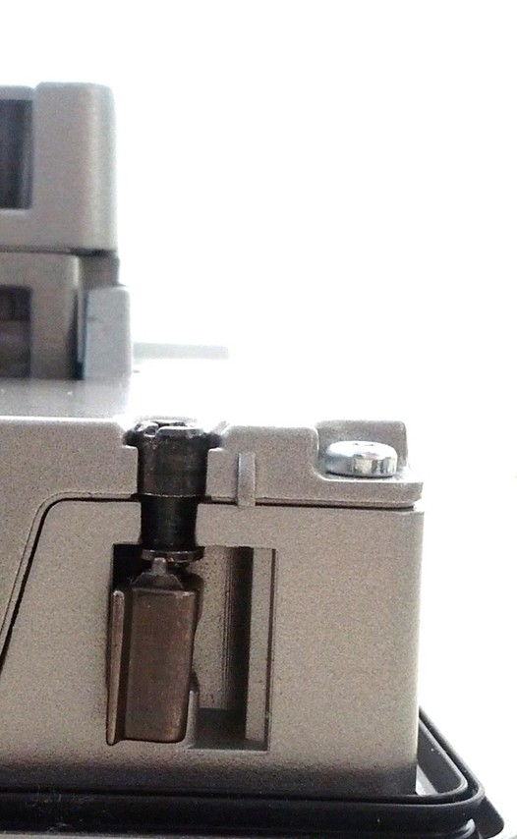
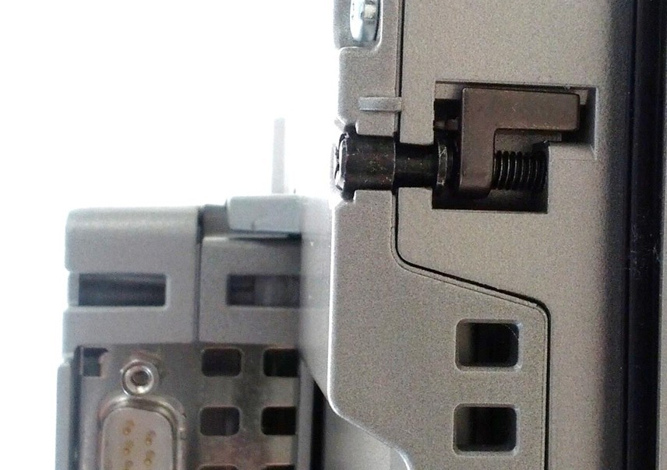
More efficient instruction
Simple to use
Function
Easy and Simple mounting
Thanks to Built-in Fastener,
Not drop and Not loose
Applying for a patent
Loosen
Fasten

Slide 21
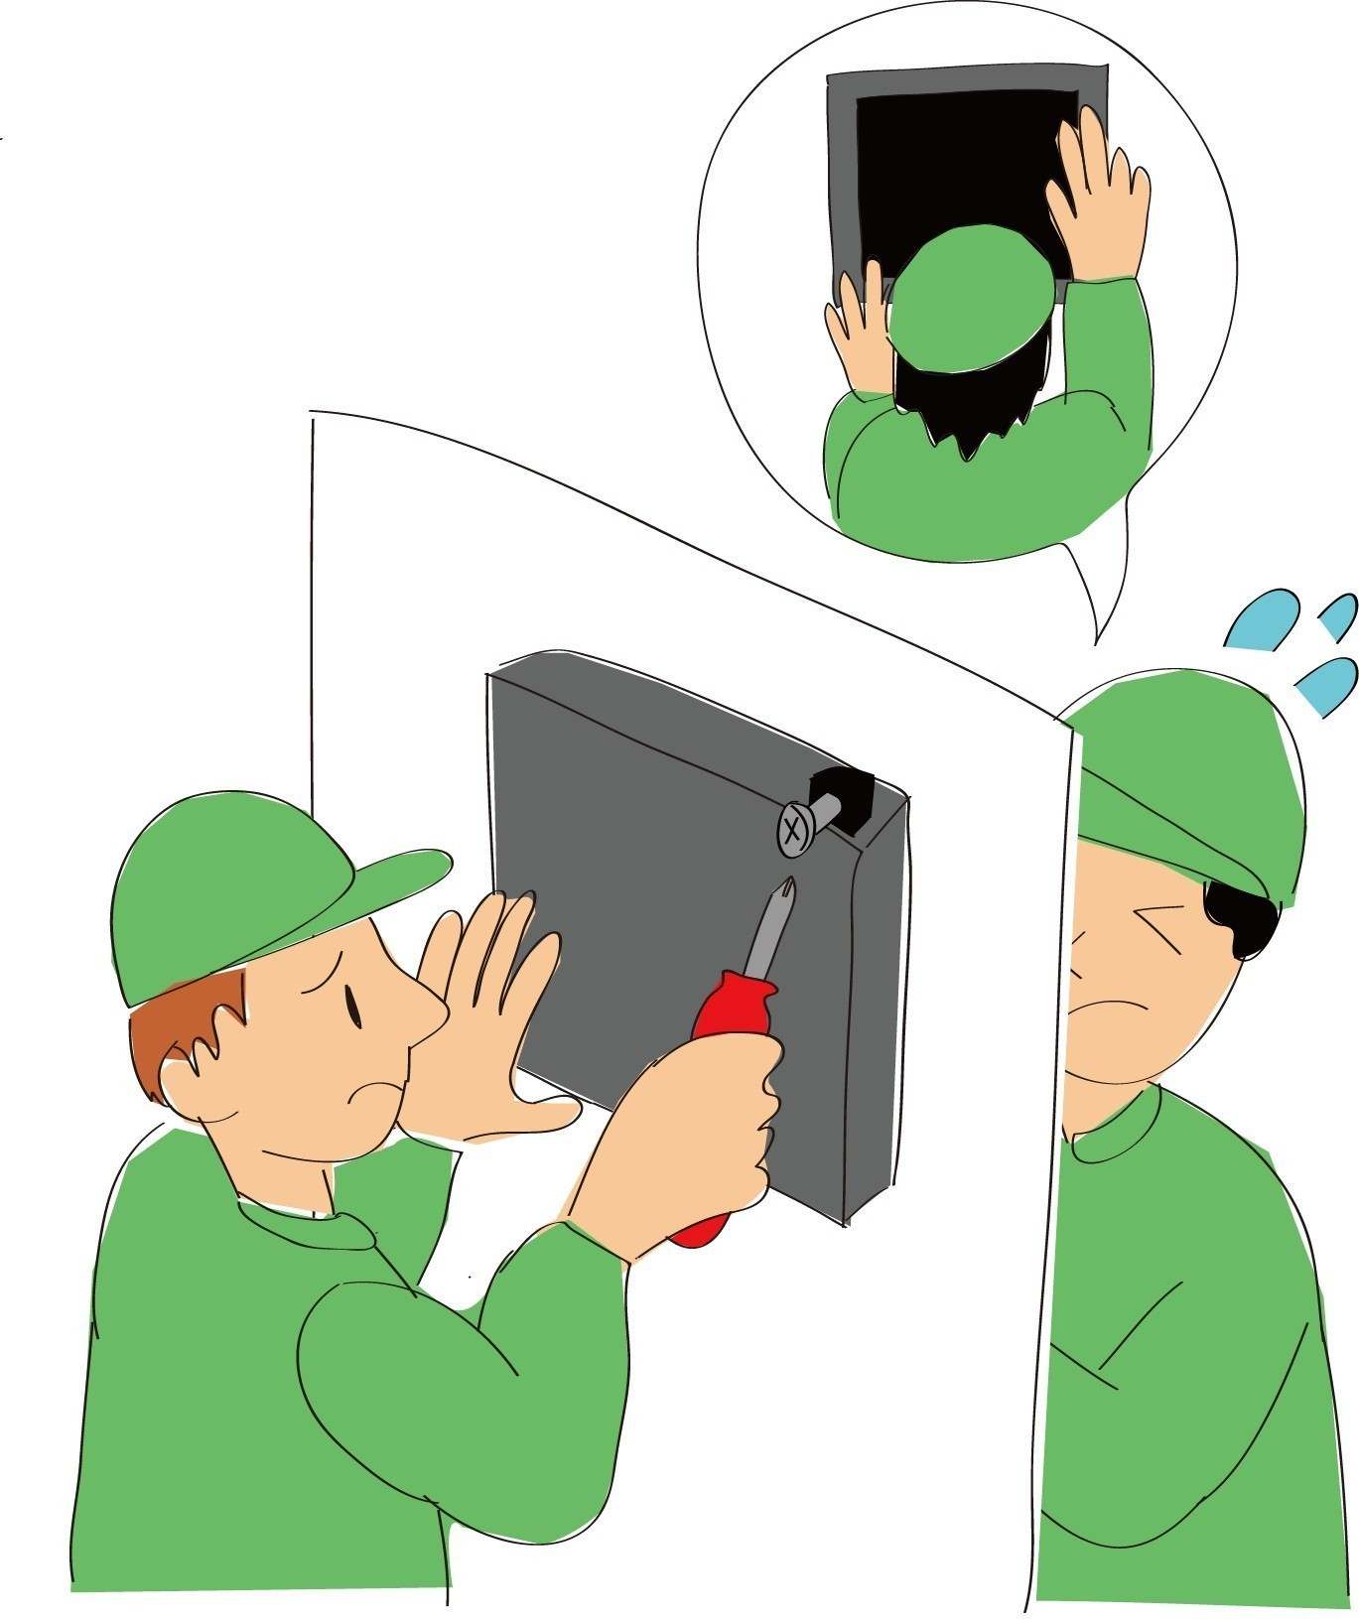

Not as simple as it seems to install panel?
Simple to use
Current issue
Need to wait other people finish
his work
Worry about if drop panel,
because not fasten from front side
if install by one person
Loose fastener at the field and
Not mounting

Slide 22
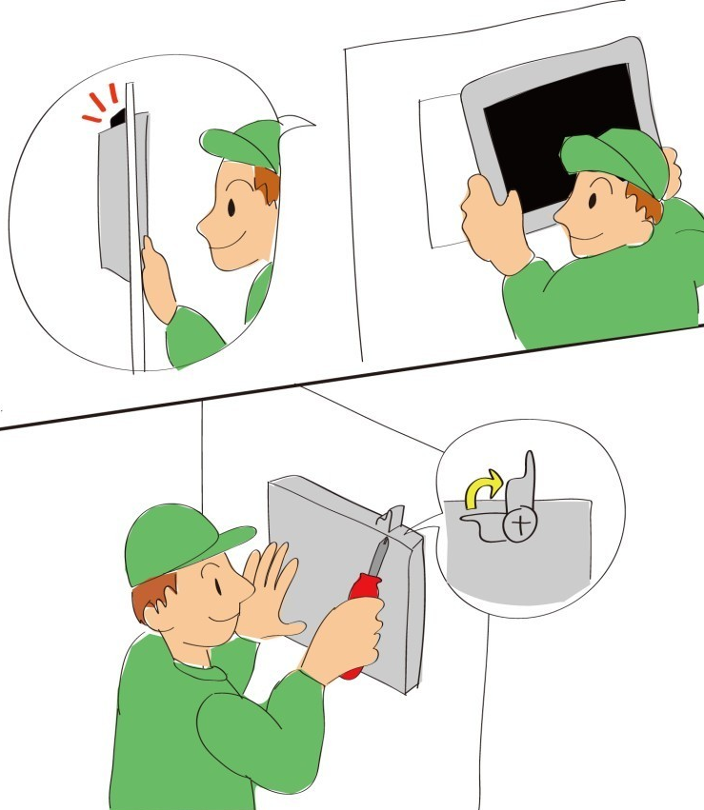
Speedy! Install by yourself
Simple to use
Your value
Anti-drop pin
& Build-in installation fastener
No need to fasten from front side
Install by yourself
and reduce time to set up
No need to worry to lose
installation fastener
Thanks to easy
installation/de-installation,
Every one can make it
(End-User can replace by themselves)

Slide 23
Much improve visibility
Valuable information
Function
Clear
x8 faster processing speed
High resolution Display
Hi-colors (1.6B or 262M colors)
x2 bigger memory size
Reliable system (Real time OS)
*Power Box
High speed
Reliable
x8 faster
processing speed

Slide 24
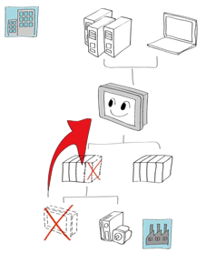
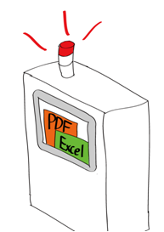
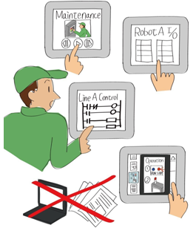
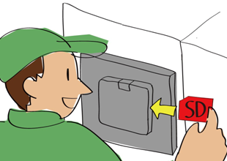
Review your value with SP5000 Series
Valuable information
Secure data handling
Valuable information
Secure data handling
Quick recovery
Less fail, secure system
Effective debug
Simple & Secure connection
Smarter Operation
Increase Operability
Smart Portal
Smart Portal
Optimized information
Optimized information
Simple to use
Simple to use
Easy replacement
One source for multi screen
Easy installation
Notes:
SP = Smart Portal → It will be window for Machines (Facility) . It means that if there is a SP5000 Series on machines, people know status of the machines and connect machines to enterprise network system
SP5000 Series offer following three elements
1. Provide more valuable information for operators and maintenance people for more effective operations, sooner actions, and reduce cost
2. Connect controllers info to enterprise network safe and stable. → we could not image to use tablet at factory three years ago, but now we see some customers start using it. We think in near future, cloud service or Big data management will be key for manufacturing. Then SP5000 Series will be key devices to achieve the system.
3. And SP5000 Series is easier mounting and easier maintenance. So customers can easily put the such intelligent devices to their machines.

Slide 25
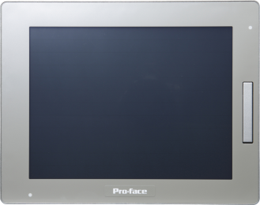
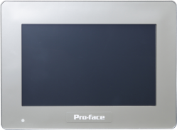
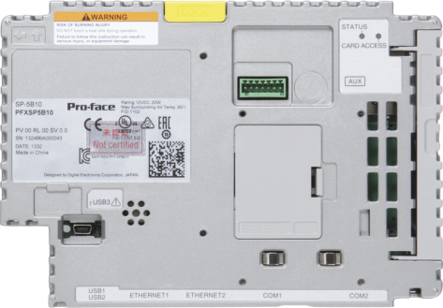





Line-up
Premium Display
Advanced display
Box module
SP-5500TP
SP-5400WA
SP-5B10
10.4”
(800 x 600)
7” wide
(800 x 480)
（Power Box: Real Time OS）
SP-5600TP
SP-5500WA
12.1”
(1024 x 768)
10.1” wide
(1280x 800)
SP-5B40
（Open Box: WES7+WinGP）
SP-5700TP
SP-5600WA
15.0”
(1024 x 768)
12.1” wide
(1280x 800)

